Slide 1
Biostatistics 699
Project 2
Modeling of survival for patients with liver cancer treated with radiation therapy
Will Jackson (wcj@med.umich.edu), 01/23/2017
RADIATION ONCOLOGY

Slide 2
Overview
Background
Clinical problem
Introduction to data set
Project goals
RADIATION ONCOLOGY

Slide 3
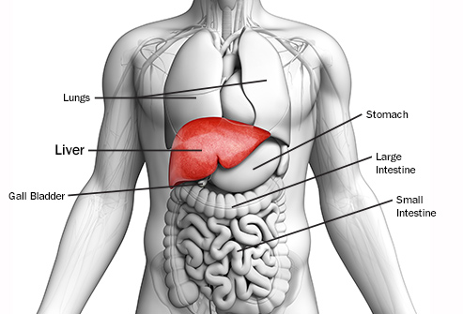
Background
Liver cancer can broadly be split into two groups
Hepatocellular carcinoma
Liver metastases
Hepatocellular carcinoma is the 3rd leading cause of cancer mortality worldwide
Incidence and mortality continue to increase
We will be focusing on hepatocellular carcinoma
RADIATION ONCOLOGY

Slide 4
Background
Treatment options for hepatocellular carcinoma
Surgical resection
Radiation therapy
Chemotherapy (or other systemic therapies)
Transarterial chemoembolization (TACE)
Radiofrequency ablation (RFA)
Microwave ablation
Theraspheres
RADIATION ONCOLOGY

Slide 5
Background
While surgical resection is the gold standard treatment for hepatocellular carcinoma, the vast majority of patients are not surgical candidates
Radiation therapy is an effective and non-invasive treatment option for hepatocellular carcinoma
RADIATION ONCOLOGY

Slide 6
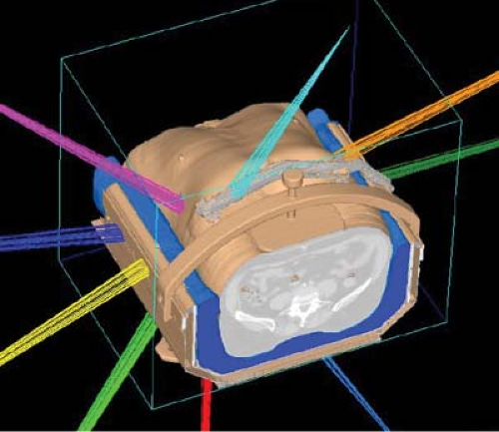
Background
Radiation therapy is delivered with a technique called stereotactic body radiation therapy (SBRT)
Usually delivered over 3-5 total treatments
Treatments are referred to as fractions
RADIATION ONCOLOGY

Slide 7
Background
Many patients with hepatocellular cancer have underlying liver disease or dysfunction
Most commonly secondary to cirrhosis
Secondary to alcohol abuse
Hepatitis B & C
Non alcoholic fatty liver disease
The presence of underlying liver dysfunction is a risk factor for death
RADIATION ONCOLOGY

Slide 8
Clinical problem
Before treating a patient with hepatocellular cancer with radiation therapy, clinicians would like to be able to estimate the patient’s life span
Following treatment, clinicians would like to incorporate a patient’s response to treatment to estimate post-treatment prognosis
Patients want to know prognosis
May or may not make sense to treat a patient with a very limited life span
Need to consider the impact that radiation may have on worsening a patients liver function
RADIATION ONCOLOGY

Slide 9
Clinical problem
To answer these questions, we have provided a database of patients treated with SBRT for hepatocellular cancer here at the University of Michigan
The patients were followed post-treatment and death outcomes were recorded
RADIATION ONCOLOGY

Slide 10
Introduction to data set / additional background
All patients have a radiation treatment start date and end date
Some patients may have been treated to different sites in the liver at different points in time
Many patients had received some form of previous liver treatment
RADIATION ONCOLOGY

Slide 11
Introduction to data set / additional background
Patients were most commonly treated with 3 to 5 total SBRT treatments (3-5 fractions)
Some patients had fiducial markers placed near the liver tumor prior to treatment to help guide delivery of treatment
The unit of dose delivered via radiation is called the Gray (J/kg)
RADIATION ONCOLOGY

Slide 12
Introduction to data set / additional background
Patients could be treated with the same or different doses of radiation therapy with each treatment fraction
We are usually most interested in the total dose delivered over the entire course of treatment
To allow comparison of patients treated with different doses of radiation per fraction, two methods exist to convert the delivered dose into an “equivalent dose”
Equivalent dose in 2 Gy fractions (EQD2)
Biologically equivalent dose (BED)
RADIATION ONCOLOGY

Slide 13
Introduction to data set / additional background
While increasing dose to the liver tumor is thought to increase the likelihood of killing the tumor, it also increases the total radiation dose delivered to the surrounding liver
Radiation therapy to non-tumor liver can cause worsening liver dysfunction
Dose to the “normal liver” is represented through Mean Liver Dose
RADIATION ONCOLOGY

Slide 14
Introduction to data set / additional background
In order to decrease the likelihood of permanently damaging functioning liver with radiation therapy in patients with already compromised liver functions, many patients were treated in an adaptive fashion.
3 fractions delivered on every other day → 1 month break → deliver 2 additional fractions if liver function has not significantly worsened
Sometimes the dose of the last 2 fractions would be reduced in an attempt to avoid treatment related toxicity (decline in liver function)
Some patients were treated with no treatment break
RADIATION ONCOLOGY

Slide 15
Introduction to data set / additional background
How do we measure baseline liver function and changes in liver function over time?
RADIATION ONCOLOGY

Slide 16
Introduction to data set / additional background
Liver function scores:
Child Pugh Score
Albumin Bilirubin (ALBI) grade
Indocyanine green (IC-green) clearance
RADIATION ONCOLOGY

Slide 17
Child Pugh Classification
Child-Pugh Score
Clinical score of liver disease severity
Score correlates with survival
Child Class A: 5-6 points, B: 7-9 points, C: 10-15 points
Factor | Points
 | 1 | 2 | 3
Bilirubin | <2 | 2-3 | >3
Albumin | >3.5 | 2.8-3.5 | <2.8
INR | <1.7 | 1.7-2.3 | >2.3
Ascites | None | Slight | Moderate
Encephalopathy | None | Mild-Moderate | Severe
RADIATION ONCOLOGY

Slide 18
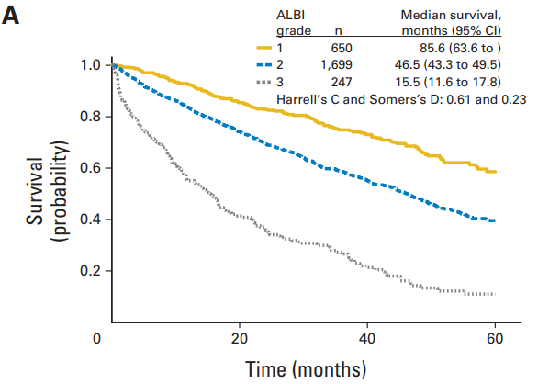
Albumin-Bilirubin grade (ALBI)
Child Pugh system is limited by the subjective grading of ascites and encephalopathy
ALBI grade was created as a simple, non-subjective, tool to predict survival in patients with HCC
Grade 1: ≤ -2.60
Grade 2: -2.61 to -1.39
Grade 3: > -1.39
Johnson et al., J Clin Oncol 2015
RADIATION ONCOLOGY

Slide 19
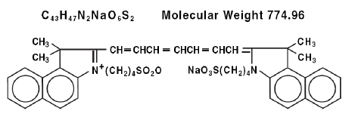
Indocyanine green (IC-Green)
Inert water soluble compound
Following IV administration
Selectively taken up by liver cells and cleared from the blood stream
Direct measure of liver function
RADIATION ONCOLOGY

Slide 20
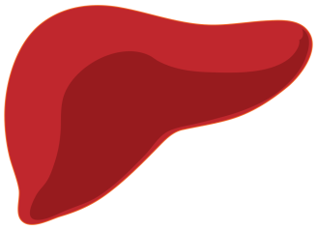
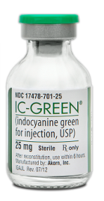

Indocyanine green clearance
Indocyanine green clearance (ICG-15)
ICG-15 < 44%
Proceed with final 2 fractions
Withhold final 2 fractions
ICG-15 > 44%
RADIATION ONCOLOGY

Slide 21
Introduction to data set / additional background
We do not know which of these three tools is the best predictor for death in patients with hepatocellular cancer treated with radiation therapy

Slide 22
Introduction to data set / additional background
Following treatment, patients were followed clinically
Lab values, including IC-green, were assessed:
pre-treatment
1 month post the initial 3 treatment fractions if adapted
1 month after completion of treatment
2 months post treatment
3 months post treatment
ALBI score and Child Pugh were recorded at baseline, 3, 6, 9, and 12 months post-treatment
RADIATION ONCOLOGY

Slide 23
Additional terms in the data set
Portal vein thrombosis
ECOG score
RADIATION ONCOLOGY

Slide 24
Goals for project
1) Use baseline measures to help predict survival of patients after treatment
2) Determine which of the three lab measures appears to be “best” for predicting death:
Child Pugh Score
ALBI Score
Indocyanine Green Clearance
RADIATION ONCOLOGY

Slide 25
Questions?
RADIATION ONCOLOGY

